Slide 1
DSA
Lecture#17

Slide 2
Hashing data structure
Efficiently stores and retrieves data in a way that allows for quick access.
It involves mapping data to a specific index in a hash table by using a hash function based on its key.
This method is commonly used in databases.

Slide 3
How does hashing work?
Hash Function:
You provide your data items into the hash function.
Hash Code:
The hash function crunches the data and give a unique hash code.
Hash Table:
The hash code then points you to a specific location within the hash table.

Slide 4

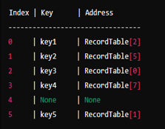
Hash table
Also known as hash map contains keys and references to the actual records.
While the record table stores the actual records.

Slide 5
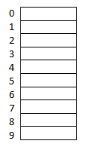
Example
Search key: (11,13,43,52,115,…)
Hash table
Hash function:
K mod n, mid square, folding method

Slide 6
Cont…
11mod10 →1
13mod10 →3
43mod10 →3
52mod10 →2
115mod10 →5

Slide 7

Hash collision
A hash collision occurs when two different keys map to the same index in the hash table.
Example:

Slide 8
Methods to handle collision
Chaining / Open hashing
Open Addressing/ Closed hashing

Slide 9
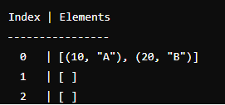
Chaining
When a collision occurs, the new key-value pair is added to the linked list at the
hashed index.
If keys 10 and 20 both hash to index 0, the linked list at index 0 will
store both pairs (10, "A") and (20, "B").
Example:

Slide 10
Open Addressing
When a collision occurs, the hash table looks for the next available slot according to a probing sequence.
Several probing techniques are used but we discuss here about the linear probing.

Slide 11
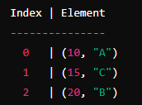
Linear Probing
If a collision occurs at index i, check the next index (i+1)mod n, then (i+2)mod n, and so on, until an empty slot is found.
Example: If keys 10 and 20 both hash to index 0 and index 1 is already occupied, key 20 will be placed in the next available slot, index 2 by using the linear probing formula as discussed above.

Slide 12

Introduction To
M- Way Tree &
B-Tree

Slide 13
M-Way Tree
An M-way (multi-way) tree has the following properties:
Each node in the tree can have at most m children.
Nodes in the tree have at most(m-1) key fields and have pointers (references)to the children.

Slide 14
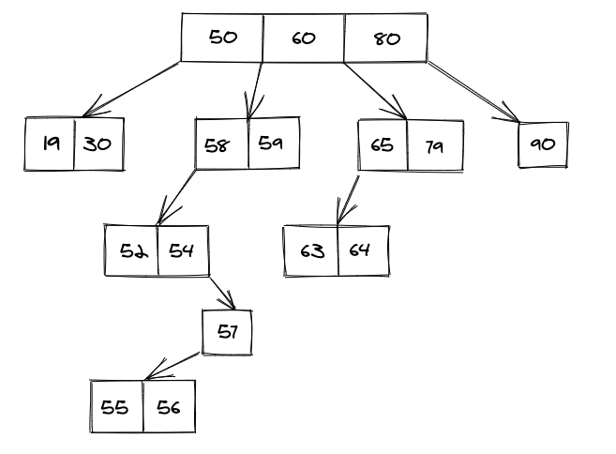
Pictorial Representation of M-Way Tree
A 4-Way Tree:

Slide 15
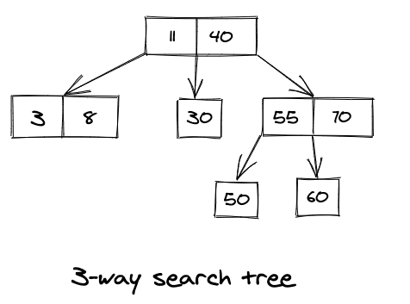
M-Way Search Tree

Slide 16
B-Tree
It is an extension of M-way tree, having the following properties:
All leaf nodes are at the same level.
All internal nodes must have ⌈M/2⌉to M children.
If the root node is a non leaf node, then it must have at least two children.
All nodes except the root node, must have at least ⌈M/2⌉-1 keys and at most m-1 keys.

Slide 17
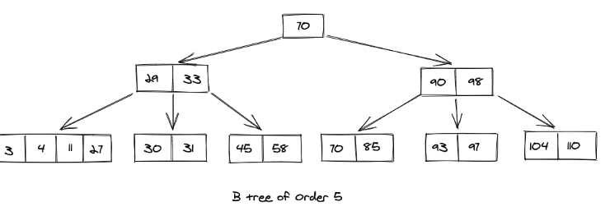
Pictorial Representation of B-Tree

Slide 18
THANK
YOU

